Slide 1
Summarizing answers in non-factoid community Question-answering
Speaker: Jim-An Tsai
advisor: professor Jia-Lin Koh
Author: Hongya Songy, Zhaochun Renz, Shangsong Liangz, Piji Lix, Jun May, Maarten de Rijkeq
Date: 2018/5/15
Source: WSDM’17

Slide 2
Outline
Introduction
Method
Experiment
Conclusion

Slide 3
Community Question-Answering(CQA)

Slide 4
Factoid(simple) & Non-Factoid CQA
Factoid Question:
Where was X born? ➔ Taipei
Non-Factoid Question:
How do you cure indigestion? ➔
Eating a great deal of red meat and fast foods is not good for the digestion of foods and moving them along the intestinal track.
Start eating more foods from the fruit and vegetable group and things should begin to improve.

Slide 5
Purpose

Slide 6
Outline
Introduction
Method
Experiment
Conclusion

Slide 7
Notation

Slide 8
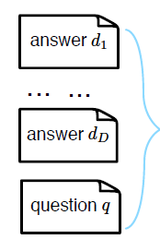
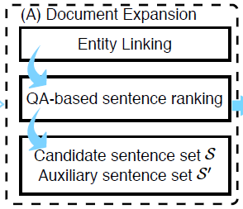
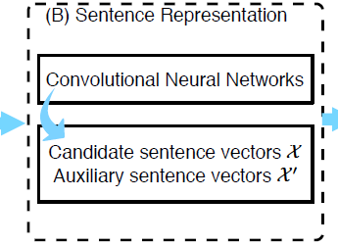
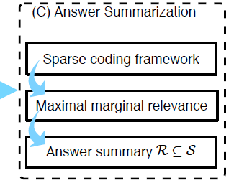
Framework
The shortness of answers in a non-factoid query
the sparsity problem in short texts
the diversity challenge

Slide 9
Entity Linking
Link Candidates
Entity e1
………
Entity en
Step 1:
Answer d: Drink a latte!
g1
(Wikepedia article)
Step 2:
Remove stop words, combine words in each sentences s
Notes:
https://blog.csdn.net/heiyeshuwu/article/details/55669316 BM25

Slide 10
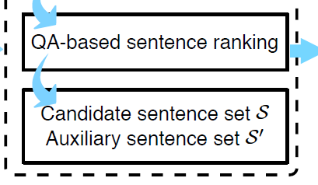
QA-based sentence ranking
Build the similarity matrix M
transition matrix
where equals the number of sentences in Wikipedia documents
that have been linked to the anchor text g
Extract the top sentences, denoted as
Notes:
http://highscope.ch.ntu.edu.tw/wordpress/?p=51085

Slide 11
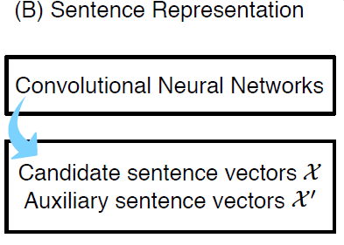
Convolutional neural networks
Notes:
https://medium.com/@yehjames/%E8%B3%87%E6%96%99%E5%88%86%E6%9E%90-%E6%A9%9F%E5%99%A8%E5%AD%B8%E7%BF%92-%E7%AC%AC5-1%E8%AC%9B-%E5%8D%B7%E7%A9%8D%E7%A5%9E%E7%B6%93%E7%B6%B2%E7%B5%A1%E4%BB%8B%E7%B4%B9-convolutional-neural-network-4f8249d65d4f
https://medium.com/@yehjames/%E8%B3%87%E6%96%99%E5%88%86%E6%9E%90-%E6%A9%9F%E5%99%A8%E5%AD%B8%E7%BF%92-%E7%AC%AC5-1%E8%AC%9B-%E5%8D%B7%E7%A9%8D%E7%A5%9E%E7%B6%93%E7%B6%B2%E7%B5%A1%E4%BB%8B%E7%B4%B9-convolutional-neural-network-4f8249d65d4f

Slide 12
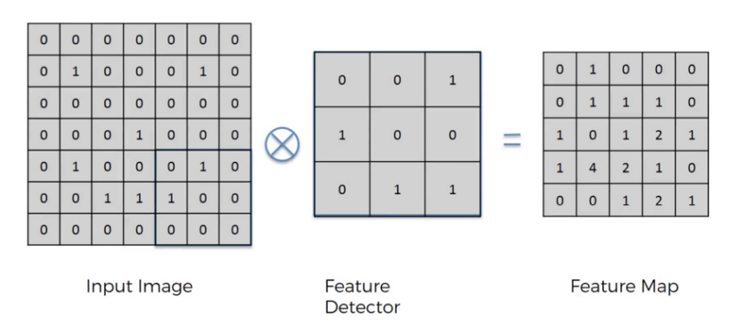
Convolution Layer

Slide 13
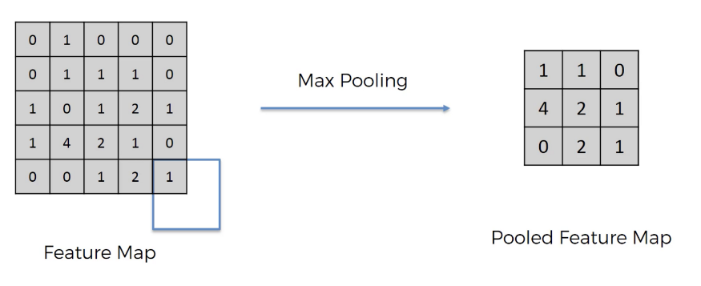
Pooling Layer

Slide 14
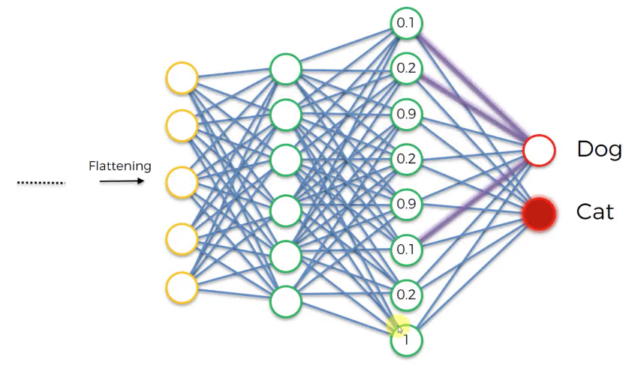
Fully Connected Layer

Slide 15
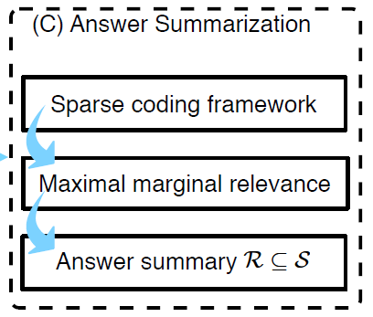
Answer summarization

Slide 16
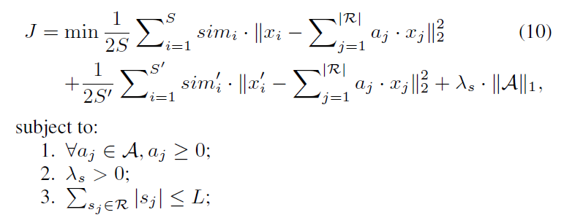
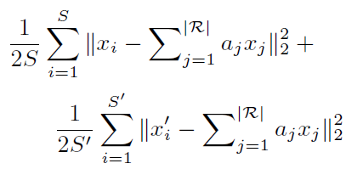
Sparse Coding
Our target: find Saliency vector A
Notes:
https://blog.csdn.net/walilk/article/details/78175912
https://kknews.cc/zh-tw/news/r864x4.html

Slide 17
Maximal marginal relevance (MMR) algorithm
Notes:
https://blog.csdn.net/eliza1130/article/details/24033161

Slide 18
Outline
Introduction
Method
Experiment
Conclusion

Slide 19
Research questions

Slide 20
RQ1
Notes:
https://blog.csdn.net/qq_25222361/article/details/78694617

Slide 21
RQ2

Slide 22
RQ3

Slide 23
RQ4

Slide 24
Outline
Introduction
Method
Experiment
Conclusion

Slide 25
Conclusion
We consider the task of answer summarization for non-factoid community question-answering.
We identify the main challenges: the shortness and sparsity of answers, and the diverse aspect distribution.

